Slide 1
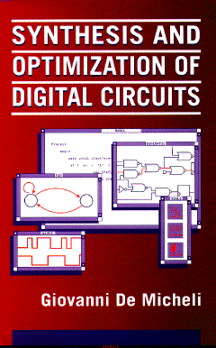


Sequential Logic Synthesis
Giovanni De Micheli
Integrated Systems Centre
EPF Lausanne
This presentation can be used for non-commercial purposes as long as this note and the copyright footers are not removed
© Giovanni De Micheli – All rights reserved

Slide 2
Module 1
Objective
  Motivation and assumptions for sequential synthesis
  Finite-state machine design and optimization

Slide 3
Synchronous logic circuits
Interconnection of
  Combinational logic gates
  Synchronous delay elements
    Edge-triggered, master/slave
Assumptions
  No direct combinational feedback
  Single-phase clocking
Extensions to
  Multiple-phase clocking
  Gated latches

Slide 4
Modeling synchronous circuits
State-based model:
  Model circuits as finite-state machines (FSMs)
  Represent by state tables/diagrams
  Apply exact/heuristic algorithms for:
    State minimization
    State encoding
Structural model
  Represent circuit by synchronous logic network
  Apply
    Retiming
    Logic transformations

Slide 5
Modeling synchronous circuits
Advantages and disadvantages of models
State-based model
  Explicit notion of state
  Implicit notion of area and delay
Structural model
  Implicit notion of state
  Explicit notion of area and delay
Transition from a model to another is possible
  State encoding
  State extraction

Slide 6
Modeling synchronous circuits
Circuit are modeled in hardware languages
  Circuit model may be directly related to FSM model
    Description by: switch-case
  Circuit model may be structural
    Explicit definition of registers
Sequential circuit models can be generated from high-level models
  Control generation in high-level synthesis

Slide 7
Sequential logic optimization
Typical flow
  Optimize FSM state model first
    Reduce complexity of the model
    E.g., apply state minimization
    Correlates to area reduction
  Encode states and obtain a structural model
    Apply retiming and transformations
    Achieve performance enhancement
  Use state extraction for verification purposes

Slide 8
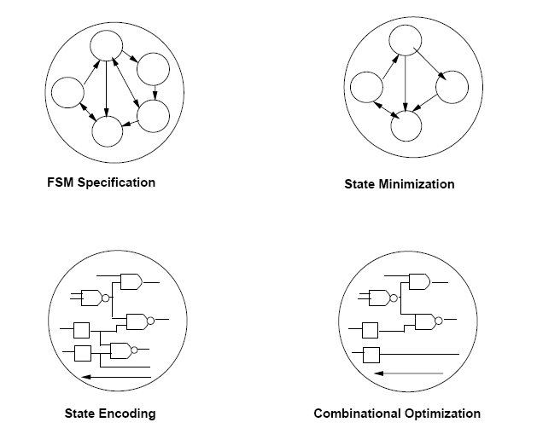
State-based optimization

Slide 9
Formal finite-state machine model
A set of primary input patterns X
A set of primary output patterns Y
A set of states S
A state transition function: δ: X × S → S
An output function:
  λ: X × S → Y for Mealy models
  λ: S → Y for Moore models

Slide 10
State minimization
Classic problem
  Exact and heuristic algorithms are available
  Objective is to reduce the number of states and hence the area
Completely-specified finite-state machines
  No don’t care conditions
  Polynomial-time solutions
Incompletely-specified finite-state machines
  Unspecified transitions and/or outputs
    Usual case in synthesis
  Intractable problem:
    Requires binate covering

Slide 11
State minimization for completely-specified FSMs
Equivalent states:
  Given any input sequence, the corresponding output sequence match
Theorem:
  Two states are equivalent if and only if:
    They lead to identical outputs and their next-states are equivalent
Equivalence is transitive
  Partition states into equivalence classes
  Minimum finite-state machine is unique

Slide 12
State minimization for completely-specified FSMs
Stepwise partition refinement:
  Initially:
    All states in the same partition block
  Iteratively:
    Refine partition blocks
  At convergence:
    Partition blocks identify equivalent states
Refinement can be done in two directions
  Transitions from states in block to other states
    Classic method. Quadratic complexity
  Transitions into states of block under consideration
    Inverted tables. Hopcroft’s algorithm.

Slide 13
Example of refinement
Initial partition:
  Π₁ : States belong to the same block when outputs are the same for any input
Iteration:
  Π_{k+1} : States belong to the same block if they were previously in the same block and their next states are in the same block of Π_{k} for any input
Convergence:
  Π_{k+1} = Π_{k}

Slide 14
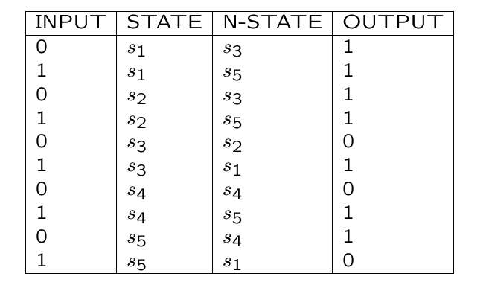
Example

Slide 15
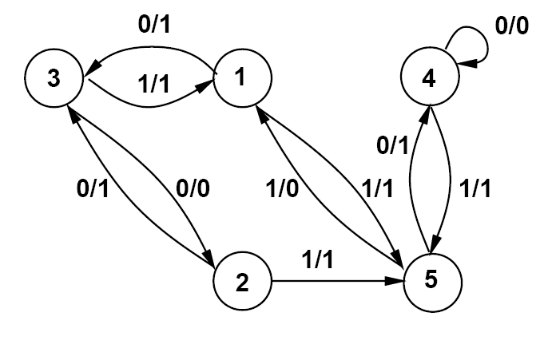
Example

Slide 16
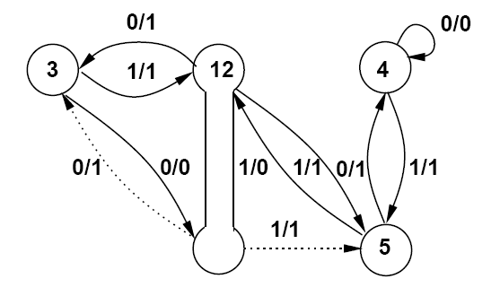
Example
Π₁ = { { s₁, s₂} , { s₃,s₄ }, { s₅ } }
Π₂ = { { s₁, s₂} , { s₃} , { s₄ }, { s₅ } }
Π₂ is a partition into equivalence classes
  No further refinement is possible
  States { s₁, s₂ } are equivalent

Slide 17
State minimization for incompletely-specified finite-state machines
Applicable input sequences
  All transitions are specified
Compatible states
  Given any applicable input sequence, the corresponding output sequence match
Theorem:
  Two states are compatible if and only if:
    They lead to identical outputs
      (when both are specified)
    And their next state is compatible
      (when both are specified)

Slide 18
State minimization for incompletely-specified finite-state machines
Compatibility is not an equivalence relation
Minimum finite-state machine is not unique
Implication relation make the problem intractable
  Two states may be compatible, subject to other states being compatible.
  Implications are binate satisfiability clauses

Slide 19
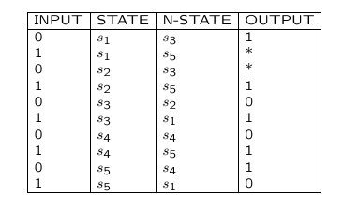
Example

Slide 20
Trivial method
Consider all possible don’t care assignments
  n don’t care imply
    2^{n} completely specified FSMs
    2^{n} solutions
Example:
  Replace * by 1
    Π₁ = { { s₁, s₂} , { s₃}, {s₄ }, { s₅ } }
  Replace * by 0
    Π₁ = { { s₁, s₅} , { s₂,s₃ , s₄ } }

Slide 21
Compatibility and implications
Example
Compatible states {s₁ , s₂}
If {s₃ , s₄} are compatible
  Then {s₁ , s₅ } are also compatible
Incompatible states {s₂ , s₅}

Slide 22
Compatibility and implications
Compatible pairs:
  {s₁, s₂}
  {s₁, s₅} ← {s₃, s₄}
  {s₂, s₄} ← {s₃, s₄}
  {s₂, s₃} ← {s₁, s₅}
  {s₃, s₄} ← {s₂, s₄} U {s₁, s₅}
Incompatible pairs
  {s₂, s₅}
  {s₃, s₅}
  {s₁, s₄}
  {s₄, s₅}
  {s₁, s₃}

Slide 23
Compatibility and implications
A class of compatible states is such that all state pairs are compatible
A class is maximal
  If not subset of another class
Closure property
  A set of classes such that all compatibility implications are satisfied
The set of maximal compatibility classes
  Has the closure property
  May not provide a minimum solutions

Slide 24
Maximum compatibility classes
Example:
  {s₁, s₂}
  {s₁, s₅} ← {s₃, s₄}
  {s₂, s₃, s₄} ← {s₁, s₅}
Cover with all MCC has cardinality 3

Slide 25
Exact problem formulation
Prime compatibility classes:
  Compatibility classes having the property that they are not subset of other classes implying the same (or subset) of classes
Compute all prime compatibility classes
Select a minimum number of prime classes
  Such that all states are covered
  All implications are satisfied
Exact solution requires binate cover
Good approximation methods exists
  Stamina

Slide 26
Prime compatibility classes
Example:
  {s₁, s₂}
  {s₁, s₅} ← {s₃, s₄}
  {s₂, s₃, s₄} ← {s₁, s₅}
Minimum cover:
  {s₁, s₅} , {s₂, s₃, s₄}
  Minimun cover has cardinality 2

Slide 27
State encoding
Determine a binary encoding of the states
  Optimizing some property of the representation (mainly area)
Two-level model for combinational logic
  Methods based on symbolic optimization
    Minimize a symbolic cover of the finite state machine
    Formulate and solve a constrained encoding problem
Multiple-level model
  Some heuristic methods that look for encoding which privilege cube and/or kernel extraction
  Weak correlation with area minimality

Slide 28

Example
INPUT | P-STATE | N-STATE | OUTPUT
0 | s1 | s3 | 0
1 | s1 | s3 | 0
0 | s2 | s3 | 0
1 | s2 | s1 | 1
0 | s3 | s5 | 0
1 | s3 | s4 | 1
0 | s4 | s2 | 1
1 | s4 | s3 | 0
0 | s5 | s2 | 1
1 | s5 | s5 | 0

Slide 29
Example
Minimum symbolic cover:
* | s1s2s4 | s3 | 0
1 | s2 | s1 | 1
0 | s4s5 | s2 | 1
1 | s3 | s4 | 1
Encoded cover :
* | 1** | 001 | 0
1 | 101 | 111 | 1
0 | *00 | 101 | 1
1 | 001 | 100 | 1

Slide 30
Summary finite-state machine optimization
FSM optimization has been widely researched
  Classic and newer approaches
State minimization and encoding correlate to area reduction
  Useful, but with limited impact
Performance-oriented FSM optimization has mixed results
  Performance optimization is usually done by structural methods

Slide 31
Module 2
Objective
  Structural representation of sequential circuits
  Retiming
  Extensions

Slide 32
Structural model for sequential circuits
Synchronous logic network
  Variables
  Boolean equations
  Synchronous delay annotation
Synchronous network graph
  Vertices ↔ equations ↔ I/O, gates
  Edges ↔ dependencies ↔ nets
  Weights ↔ synchronous delays ↔ registers

Slide 33
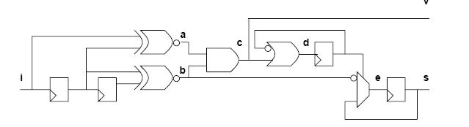
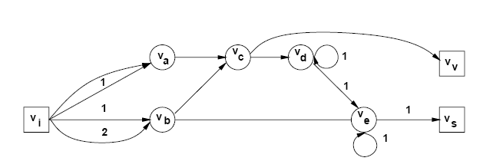
Example

Slide 34
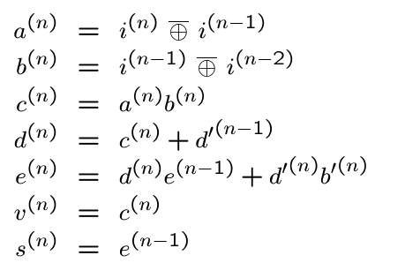
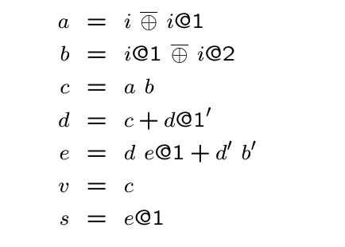
Example

Slide 35
Approaches to sequential synthesis
Optimize combinational logic only
  Freeze circuit at register boundary
  Modify equation and network graph topology
Retiming
  Move register positions. Change weights on graph
  Preserve network topology
Synchronous transformations
  Blend combinational transformations and retiming
  Powerful, but complex to use

Slide 36
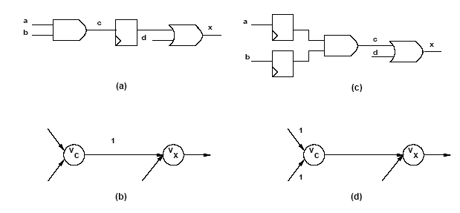
Example of local retiming

Slide 37
Retiming
Global optimization technique
Change register positions
  Affects area:
    Retiming changes register count
  Affects cycle-time
    Changes path delays between register pairs
Retiming algorithms have polynomial-time complexity

Slide 38
Retiming assumptions
Delay is constant at each vertex
  No fanout delay dependency
Graph topology is invariant
  No logic transformations
Synchronous implementation
  Cycles have positive weights
    Each feedback loop has to be broken by at least one register
  Edges have non-negative weights
    Physical registers cannot anticipate time
Consider topological paths
  No false path analysis

Slide 39
Retiming
Retiming of a vertex v
  Integer r_{v}
  Registers moved from output to input – r_{v} positive
  Registers moved from input to output – r_{v} negative
Retiming of a network
  Vector whose entries are the retiming at various vertices
A family of I/O equivalent networks are specified by:
  The original network
  A set of vectors satisfying specific constraints
    Legal retiming

Slide 40
Example
7
7
7
Original graph
v_{g}
0
0
Delay: 24
v_{f}
v_{e}
0
0
3
0
0
0
0
v_{d}
v_{h}
3
3
3
1
v_{b}
1
v_{a}
v_{c}
1
1
7
7
7
v_{g}
1
1
Retimed graph
v_{f}
v_{e}
Delay: 13
0
0
3
0
v_{d}
v_{h}
1
0
0
3
3
3
0
v_{b}
1
v_{a}
v_{c}
1
0

Slide 41
Definitions and properties
Definitions:
  w( v_{i}, v _{j}) weight on edge ( v_{i}, v_{j} )
  ( v_{i}, …, v_{j} ) path from v_{i} to v_{j}
  w( v_{i}, …, v_{j} ) weight on path from v_{i} to v_{j}
  d( v_{i}, …, v_{j} ) combinational delay on path from v_{i} to v_{j}
Properties:
  Retiming of an edge ( v_{i}, v_{j} )
    ŵ_{ij} = w_{ij} + r_{j} – r_{i}
  Retiming of a path ( v_{i}, …, v_{j} )
    ŵ ( v_{i}, …, v_{j}) = w (v_{i}, …, v_{j}) + r_{j} – r_{i}
  Cycle weights are invariant
w_{ij}
v_{i}
v_{j}

Slide 42
Legal retiming
Clock period φ
A retiming vector is legal if:
  No edge weight is negative
    ŵ_{ij} ( v_{i}, v_{j}) = w_{ij} (v_{i}, v_{j}) + r_{j} – r_{i} ≥ 0 for all i, j
  Each path ( v_{i}, …, v_{j}) with d ( v_{i}, …, v_{j}) > φ
  has at least one register:
    ŵ ( v_{i}, …, v_{j}) = w (v_{i}, …, v_{j}) + r_{j} – r_{i} ≥ 1 for all i, j
  Equivalently, each combinational path delay is less than φ

Slide 43
Refined analysis
Least-register path
  W (v_{i}, v_{j}) = min w (v_{i}, …, v_{j}) over all paths between v_{i} and v_{j}
Critical delay:
  D (v_{i}, v_{j}) = max d (v_{i}, …, v_{j}) over all paths between v_{i} and v_{j}
  with weight W (v_{i}, v_{j})
There exist a vertex pair (v_{i}, v_{j}) whose delay D (v_{i}, v_{j}) bounds the cycle time

Slide 44
Example
7
7
7
v_{g}
0
0
v_{f}
v_{e}
0
0
3
0
v_{d}
v_{h}
0
0
0
3
3
3
1
v_{b}
1
v_{a}
v_{c}
1
1
Vertices: v_{a}, v_{e}
Paths: (v_{a}, v_{b}, v_{c} , v_{e}) and (v_{a}, v_{b}, v_{c}, v_{d}, v_{e})
W(v_{a}, v_{e}) = 2
D(v_{a}, v_{e}) = 16

Slide 45
Minimum cycle-time retiming problem
Find the minimum value of the clock period φ
such that there exist a retiming vector where:
  r_{i} – r_{j} ≤ w_{ij} for all ( v_{i}, v_{j} )
    All registers are implementable
  r_{i} – r_{j} ≤ W (v_{i}, v_{j}) – 1 for all ( v_{i}, v_{j} ) such that D (v_{i}, v_{j}) > φ
    All timing path constraints are satisfied
Solution
  Given a value of φ
  Solve linear constraints A r ≤ b
    Mixed integer-linear program
  A set of inequalities has a solution if the constraint graph has no positive cycles
    Bellman-Ford algorithm – compute longest path
  Iterative algorithm
    Relaxation

Slide 46
Minimum cycle-time retiming algorithm
Compute all pair path weights W (v_{i}, v_{j}) and delays D (v_{i}, v_{j})
  Warshall-Floyd algorithms with complexity O( |V|³ )
Sort the elements of D (v_{i}, v_{j}) in decreasing order
  Because an element of D is the minimum φ
Binary search for a φ in D (v_{i}, v_{j}) such that
  There exists a legal retiming
  Bellman-Ford algorithm with complexity O( |V|³ )
Remarks
  Result is a global optimum
  Overall complexity is O( |V|³ log |V| )

Slide 47
Example: original graph
7
7
7
v_{g}
0
0
v_{f}
v_{e}
0
0
3
0
v_{d}
v_{h}
0
0
0
3
3
3
1
v_{b}
1
v_{a}
v_{c}
1
1
Constraints (first type):
  r_{a} - r_{b} ≤ 1 or equivalently r_{b} ≥ r_{a} – 1
  r_{c} - r_{b} ≤ 1 or equivalently r_{c} ≥ r_{b} – 1
  …

Slide 48
Example: constraint graph
7
7
7
r_{g}
0
0
r_{f}
r_{e}
0
0
3
0
r_{d}
r_{h}
0
0
0
3
3
3
-1
r_{b}
-1
r_{a}
r_{c}
-1
-1
Constraints (first type):
  r_{a} - r_{b} ≤ 1 or equivalently r_{b} ≥ r_{a} – 1
  r_{c} - r_{b} ≤ 1 or equivalently r_{c} ≥ r_{b} – 1
  …
-1
r_{a}
r_{b}

Slide 49
Example
Sort elements of D:
  33,30,27,26,24,23,21,20,19,17,16,14,13,12,10,9,7,6,3
Select φ = 19
  33,30,27,26,24,23,21,20,19,17,16,14,13,12,10,9,7,6,3
  Pass: legal retiming found
Select φ = 13
  33,30,27,26,24,23,21,20,19,17,16,14,13,12,10,9,7,6,3
  Pass: legal retiming found
Select φ < 13
  33,30,27,26,24,23,21,20,19,17,16,14,13,12,10,9,7,6,3
  Fail: no legal retiming found
Fastest cycle time is φ = 13. Corresponding retiming vector is used

Slide 50
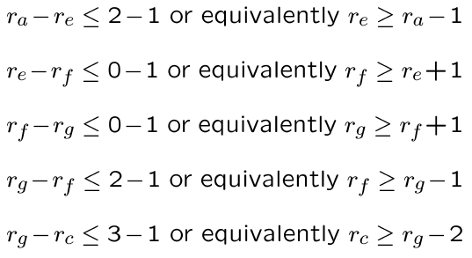
Example φ = 13
1
1
r_{g}
0
0
r_{f}
r_{e}
0
-1
0
r_{h}
-1
r_{d}
0
0
0
-2
-1
r_{b}
-1
r_{a}
r_{c}
-1
-1

Slide 51
Example φ = 13
Constraint graph:
Longest path from source
  -[12342100]
Retimed graph
1
1
r_{g}
0
0
r_{f}
r_{e}
0
-1
0
r_{h}
-1
r_{d}
0
0
0
-2
-1
r_{b}
-1
r_{a}
r_{c}
-1
-1
7
7
7
v_{g}
1
1
v_{f}
v_{e}
1
0
3
0
v_{d}
v_{h}
1
1
0
3
3
3
0
v_{b}
0
v_{a}
v_{c}
0
1

Slide 52
Example φ = 13
The solution is not unique
7
7
7
v_{g}
1
1
v_{f}
v_{e}
1
0
3
0
v_{d}
v_{h}
1
1
0
3
3
3
0
v_{b}
0
v_{a}
v_{c}
0
1
7
7
7
v_{g}
1
1
v_{f}
v_{e}
0
0
3
0
v_{d}
v_{h}
1
0
0
3
3
3
0
v_{b}
1
v_{a}
v_{c}
1
0

Slide 53
Relaxation-based retiming
Most common algorithm for retiming
  Avoids storage of matrices W and D
  Applicable to large circuits
Rationale
  Search for decreasing φ in fixed step
    Look for values of φ compatible with peripheral circuits
  Use efficient method to determine legality
    Network graph is often very sparse
  Can be coupled with topological timing analysis

Slide 54
Relaxation-based retiming
Start with a given cycle-time φ
Look for paths with excessive delays
Make such paths shorter
  By bringing the terminal register closer
  Some other paths may become longer
  Namely, those path whose tail has been moved
Use an iterative approach

Slide 55
Relaxation-based retiming
Define data ready time at each node
  Total delay from register boundary
Iterative approach
  Find vertices with data ready > φ
  Retime these vertices by 1
Algorithm properties
  If at some iteration there is no vertex with data ready > φ,
  a legal retiming has been found
  If a legal retiming is not found in |V| iterations,
  then no legal retiming exists for that φ

Slide 56
Example φ = 13 iteration = 1
7
7
7
7
7
7
v_{g}
0
0
v_{f}
v_{e}
v_{g}
v_{f}
v_{e}
0
0
3
3
0
v_{d}
0
v_{h}
0
0
0
v_{h}
v_{d}
3
3
3
3
3
3
1
v_{b}
1
v_{a}
v_{c}
v_{a}
v_{b}
v_{c}
1
1

Slide 57
Example φ = 13 iteration = 2
7
7
7
7
7
7
v_{g}
0
1
v_{f}
v_{e}
v_{g}
v_{f}
v_{e}
0
0
3
3
0
v_{d}
v_{h}
0
v_{d}
1
1
0
v_{h}
3
3
3
3
3
3
0
v_{b}
1
v_{a}
v_{c}
v_{a}
v_{b}
v_{c}
1
1

Slide 58
Example φ = 13 iteration = 3
7
7
7
7
7
7
v_{g}
1
1
v_{f}
v_{e}
v_{g}
v_{f}
v_{e}
0
0
3
3
0
v_{d}
v_{h}
0
0
v_{d}
1
1
v_{h}
3
3
3
3
3
3
0
v_{b}
1
v_{a}
v_{c}
v_{a}
v_{b}
v_{c}
0
1

Slide 59
Retiming for minimum area
Find a retiming vector that minimizes the number of registers
Simple area modeling
  Every edge with a positive weight denotes registers
  Total register area is proportional to the sum of all weights
Register sharing model
  Every set of positively-weighted edges with common tail is realized by a shift registers with taps
  Total register area is proportional to the sum, over all vertices, of the maxima of weights on outgoing edges

Slide 60
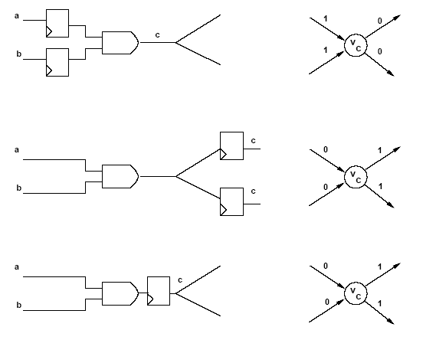
Example

Slide 61
Minimum area retiming simple model
Register variation at node v
  r_{v} ( indegree(v) – outdegree(v) )
Total area variation:
  Σ r_{v} ( indegree(v) – outdegree(v) )
Area minimization problem:
  Min Σ r_{v} ( indegree(v) – outdegree(v) )
  Such that r_{i} – r_{j} ≤ w_{ij} for all ( v_{i}, v_{j} )

Slide 62
Minimum area retiming under timing constraint
Area recovery under timing constraint
  Min Σ r_{v} ( indegree(v) – outdegree(v) ) such that:
  r_{i} – r_{j} ≤ w_{ij} for all ( v_{i}, v_{j} ) and
  r_{i} – r_{j} ≤ W (v_{i}, v_{j}) – 1 for all ( v_{i}, v_{j} ) such that D (v_{i}, v_{j}) > φ
Common implementation is by integer linear program
  Problem can alternatively be transformed into a matching problem and solved by Edmonds-Karp algorithm
Register sharing
  Construct auxiliary network and apply this formulation.
  Auxiliary network construction takes into account register sharing

Slide 63
Other problems related to retiming
Retiming pipelined circuits
  Balance pipe stages by using retiming
  Trade-off latency versus cycle time
Peripheral retiming
  Use retiming to move registers to periphery of a circuit
  Restore registers after optimizing combinational logic
Wire pipelining
  Use retiming to pipeline interconnection wires
  Model sequential and combinational macros
  Consider wire delay and buffering

Slide 64
Summary of retiming
Sequential optimization technique for:
  Cycle time or register area
Applicable to
  Synchronous logic networks
  Architectural models of data paths
    Vertices represent complex (arithmetic) operators
  Exact algorithm in polynomial time
Extension and issues
  Delay modeling
  Network granularity

Slide 65
Module 3
Objective
  Relating state-based and structural models
  State extraction

Slide 66
Relating the sequential models
State encoding
  Maps a state-based representation into a structural one
State extraction
  Recovers the state information from a structural model
Remark
  A circuit with n registers may have 2^{n} states
  Unreachable states

Slide 67
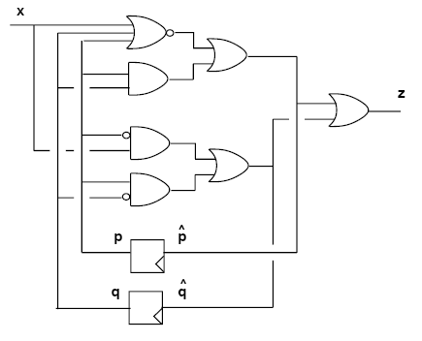
State extraction
State variables: p, q
Initial state p=0; q=0;
Four possible states

Slide 68
State extraction
Reachability analysis
  Given a state, determine which states are reachable for some inputs
  Given a state subset, determine the reachable state subset
  Start from an initial state
  Stop when convergence is reached
Notation:
  A state (or a state subset) is represented by an expression over the state variables
  Implicit representation

Slide 69
Reachability analysis
State transition function: f
Initial state: r₀
States reachable from r₀
  Image of r₀ under f
States reachable from set r_{k}
  Image of r_{k} under f
Iteration
  r_{k+1} = r_{k} U ( image of r_{k} under f)
Convergence
  r_{k+1} = r_{k} for some k

Slide 70
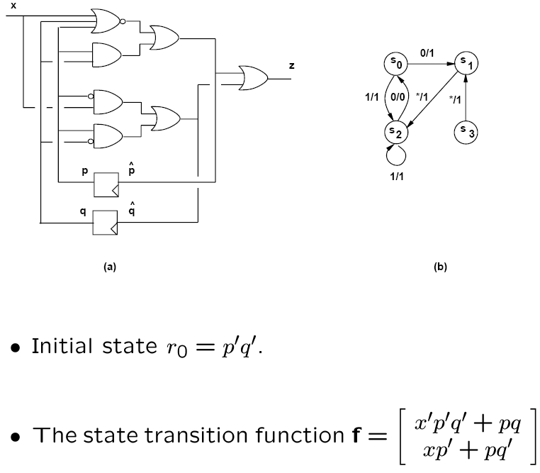
Example

Slide 71
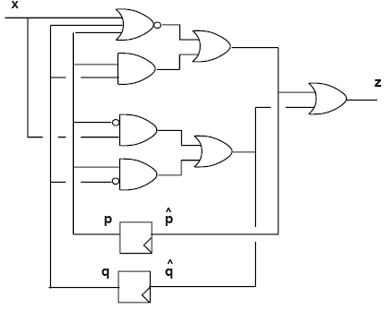
Example
Image of p’q’ under f:
  When ( p = 0 and q = 0 ), f reduces to [ x’ x ]^{T}
  Range is [ 0 1 ]^{T} U [ 1 0 ]^{T}
States reachable from the reset state:
  (p = 1; q = 0) and ( p = 0; q = 1)
  r₁ = p’q’ + pq’ + p’q = p’ + q’
States reacheable from r₁:
  [ 0 0 ]^{T} U [ 0 1 ]^{T} U [ 1 0 ]^{T}
Convergence:
  s₀ = p’q’; s₁ = pq’; s₂ = p’q;

Slide 72
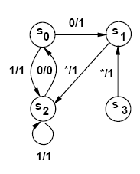
Completing the extraction
Determine state set
  Vertex set
Determine transitions and I/O labels
  Edge set
  Inverse image computation
  Look at conditions that lead into a given state

Slide 73
Example
Transition into s₀ = p’q’
  Patterns that make f = [ 0 0 ]^{T} are:
  (x’p’q’ + pq)’(xp’ + pq’)’ = x’p’q
  Transition from state s₂ = p’q under input x’

Slide 74
Remarks
Extraction is performed efficiently with implicit methods
Model transition relation χ (i,x,y) with BDDs
  This function relates possible triples:
    ( input, current_state, next_state )
  Image of r_{k}:
    S_{i,x} ( χ(i,x,y) r_{k} (x) )
    Where r_{k} depends on inputs x
  Smoothing on BDDs can be achieved efficiently

Slide 75
Summary
State extraction can be performed efficiently to:
  Apply state-based optimization techniques
  Apply verification techniques
State extraction is based on forward and backward state space traversal:
  Represent state space implicitly with BDDs
  Important to manage the space size, which grows exponentially with the number of registers

